Slide 1



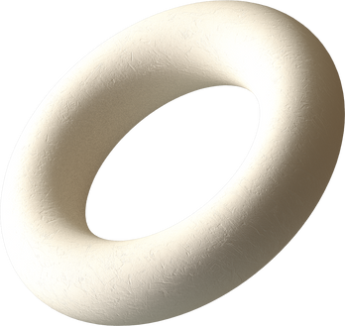

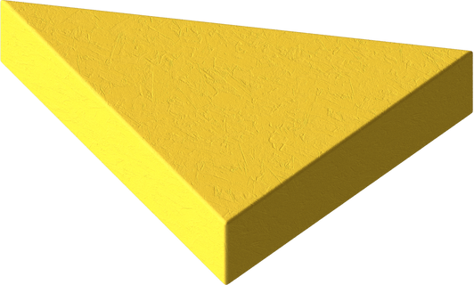




Sensors Project Tutorial 6
Obstacle Avoidance Car
Aditya Prakash Bhagchandani 7001152
Ahmed Fouad 7001708
Abdelrahman Amr Samir 7037138
Omar Mohamed Osman 7037214

Slide 2

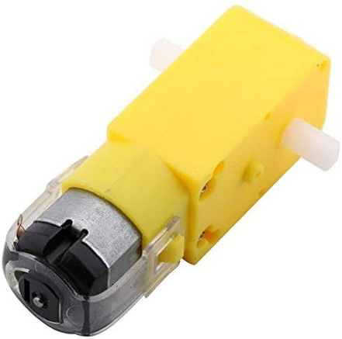
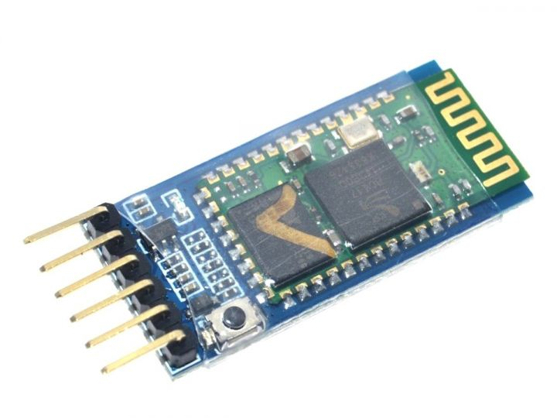
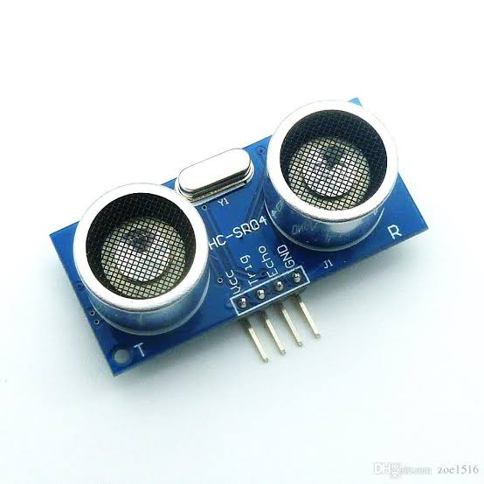
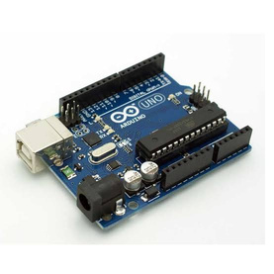
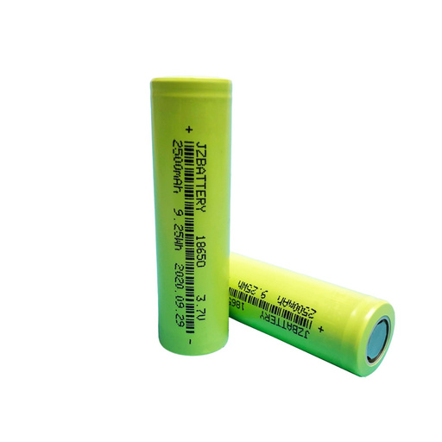
Components
Actuator
Controller
Sensor
Microcontroller
Source
HW-095 & Motors
Bluetooth
Ultrasonic
Arduino UNO
Li-Po batteries
We are connected to android phone using HC-05 module
We are using ultrasonic module to detect the distance
Everything connects to it and it manages the input and output of the data in the circuit
The car uses three
3.7 v batteries which is connected to the button to act like a switch
4 Motors connected to H-bridge
and Servo motor to the Arduino

Slide 3
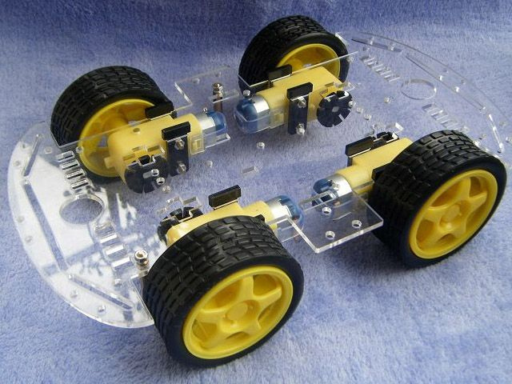
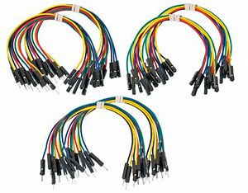

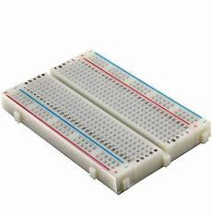
Components
Chassis
Tires
Wires
Software
Extra
Car kit and 3d printed
Car kit
Jumper wires
Arduino IDE
we used the four yellow tires that came with the car kit
We used jumper wires as they are easy to use
we used the Arduino and libraries to code the conditions into the UNO
Double sided tape to stick the Arduino and h bridge tot the car
We used readily available car kit with 3d printed holder for the sensor

Slide 4
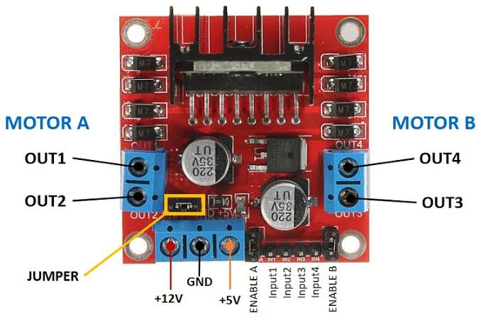
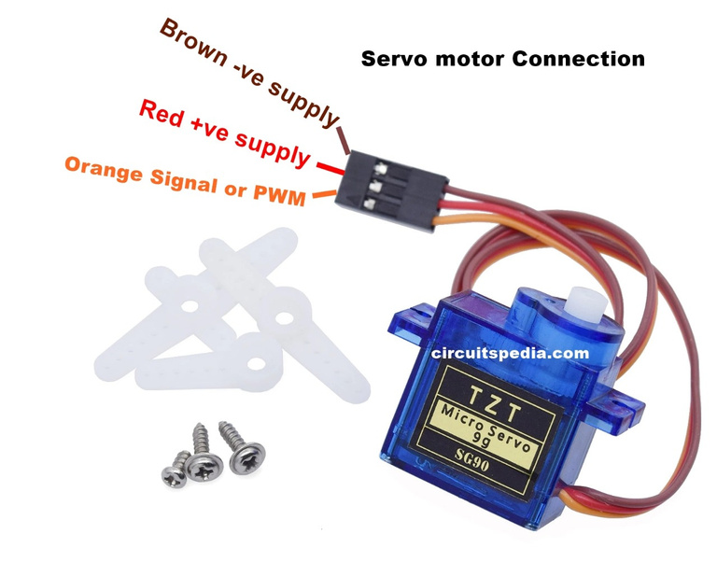
Actuator
H-Bridge
Battery --> GND & 12 V
GND & 5V --> Breadboard
O1 & O2 --> To Left Motors
O3 & O4 --> To Right Motors
IN 1,2,3,4 --> D 4,5,6,7
Servo Motor
GND & VCC --> Breadboard
Signal --> D 8

Slide 5
Sensor
GND & VCC --> Breadboard
Trig --> A0
Echo --> A1

Slide 6
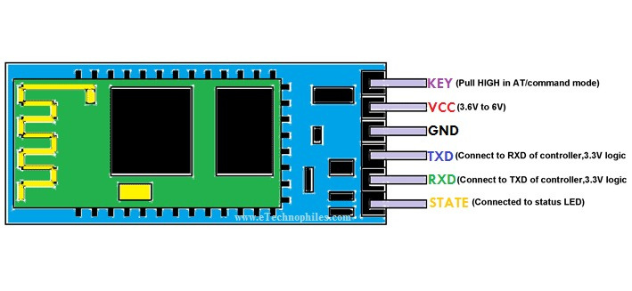
Bluetooth
GND & VCC --> Breadboard
RX --> TX
TX --> RX

Slide 7
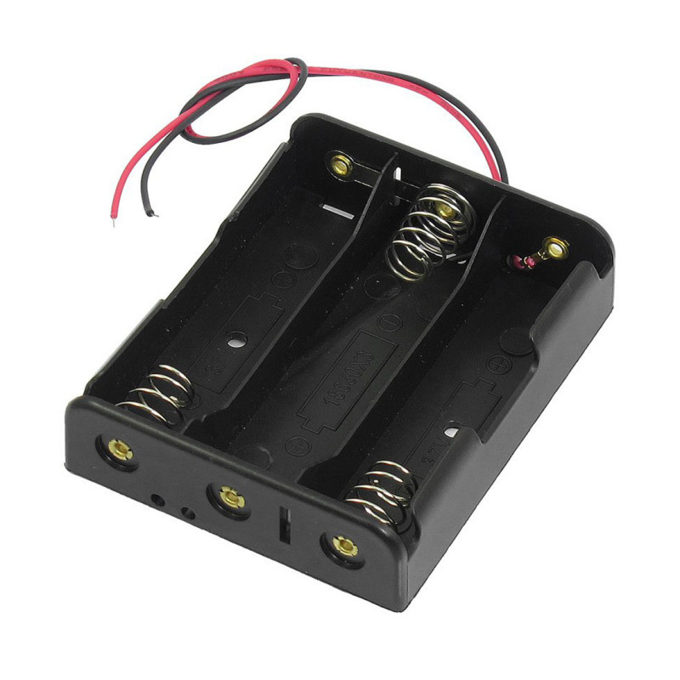
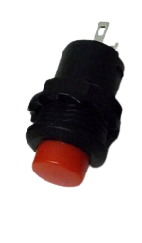
Source
Red Switch Button
3 x 3.7v batteries
Battery Holder
Battery connected to the H-Bridge

Slide 8

Extras
Wires
Breadboard
Double Side Tape

Slide 9

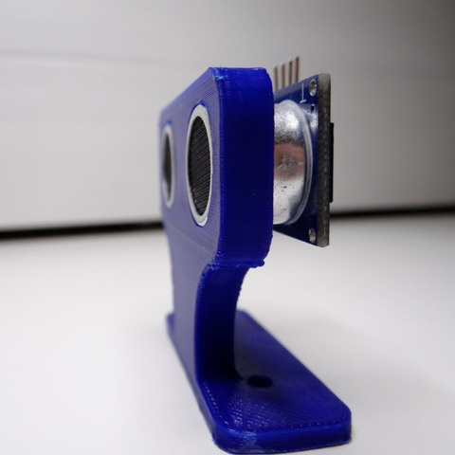
Body Kit

Slide 10
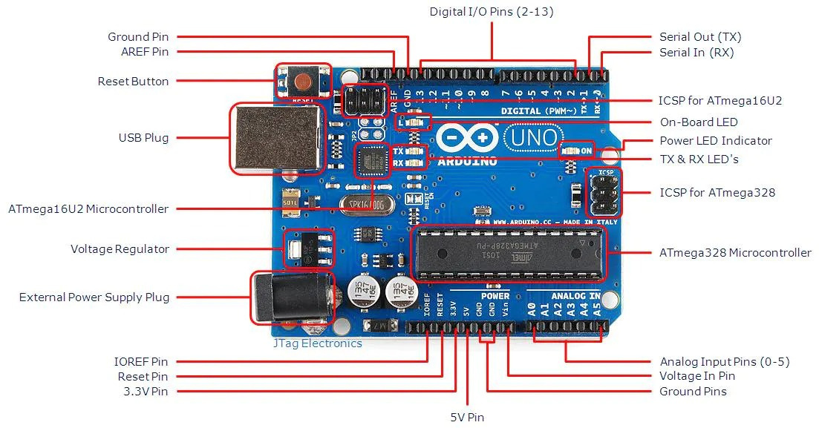
Ardunio uno
IN 1,2,3,4 --> D 4,5,6,7
GND & VIN --> Breadboard
Servo Signal --> D 8
Sensor Trig --> A0
Sensor Echo --> A1
Bluetooth RX --> TX
Bluetooth TX --> RX

Slide 11
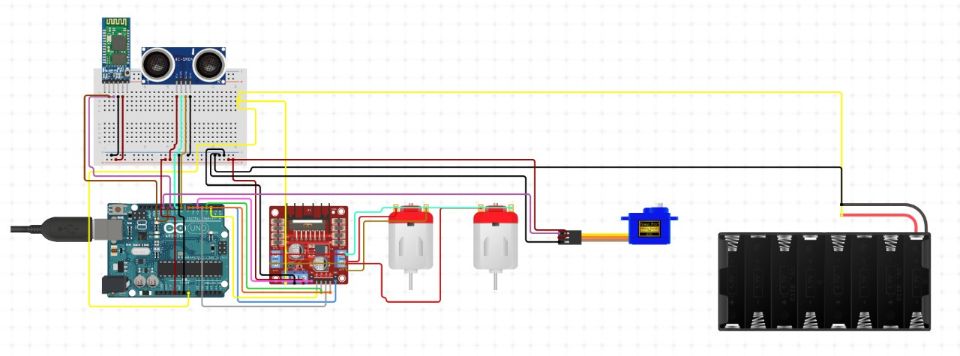

Rough Circuit Diagram
Created using Circuito.io

Slide 12




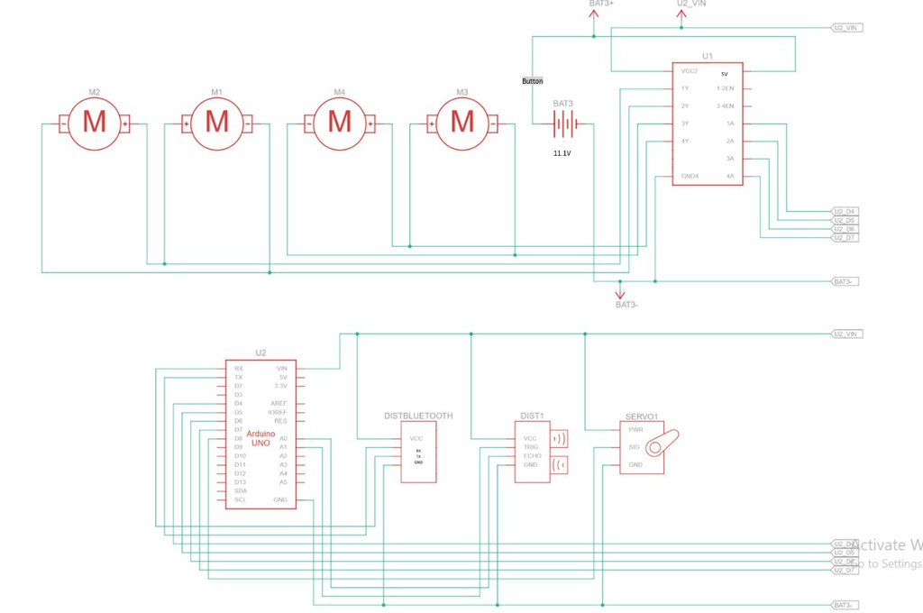
schematics
Created using tinkercad
For more clear view at the schematics

Slide 13
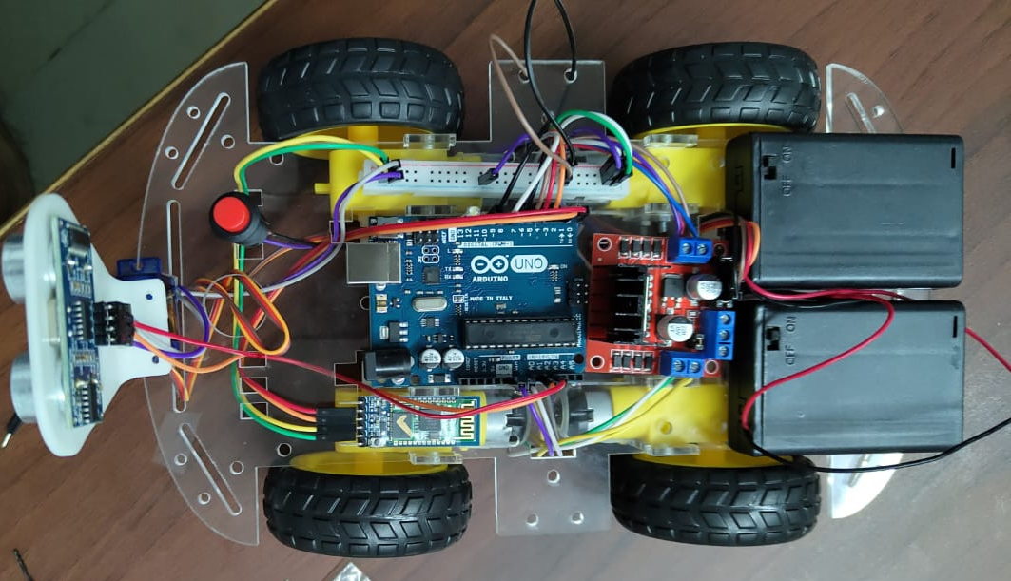
Schematics IRL
IN 1,2,3,4 --> D 4,5,6,7
Servo Signal --> D 8
Sensor Trig --> A0
Sensor Echo --> A1
Bluetooth RX --> TX
Bluetooth TX --> RX
Battery --> GND & 12 V
GND & 5V --> Breadboard
GND & VIN --> Breadboard for every component that needs powers

Slide 14
Arduino IDE | Arduino project website
Canva | Ram electronics & Amazon
Circuito.io | TinkerCad
Resource
Page

Slide 15
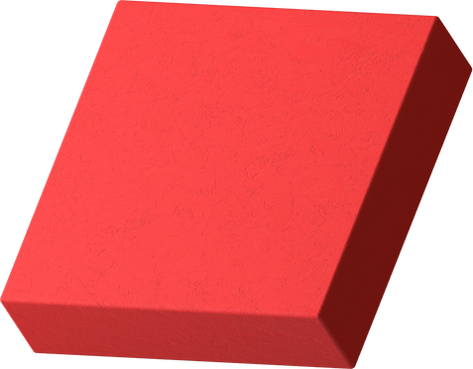


Thank You For Your Time :)
If you have any questions or if we missed out on anything let us know

